Slide 1
Distributed Computer Systems
CT024-3-3-DCOMS and VE
Blockchain Concepts

Slide 2
TOPIC LEARNING OUTCOMES
At the end of this topic, you should be able to:
1. Understand Blockchain working principle and its applications

Slide 3
Contents & Structure
Blockchain

Slide 4
Recap From Last Lesson
Define what is process?
Define what is thread?
How does the process and thread have been implemented in DS?

Slide 5
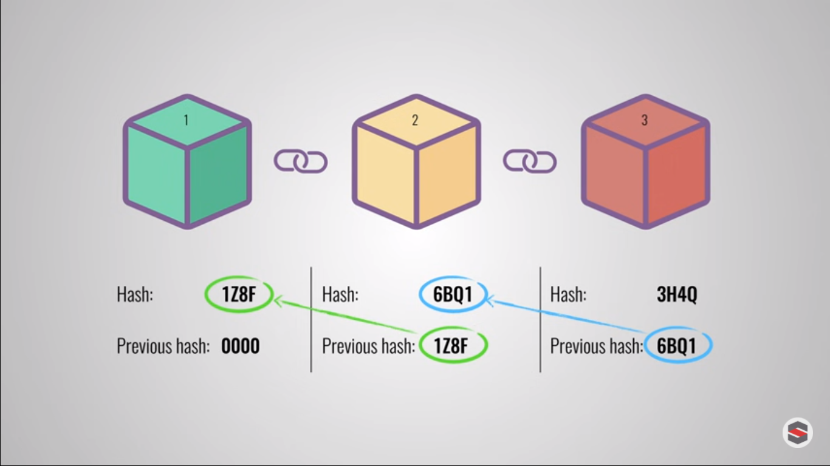
Blockchain - Storage Structures

Slide 6
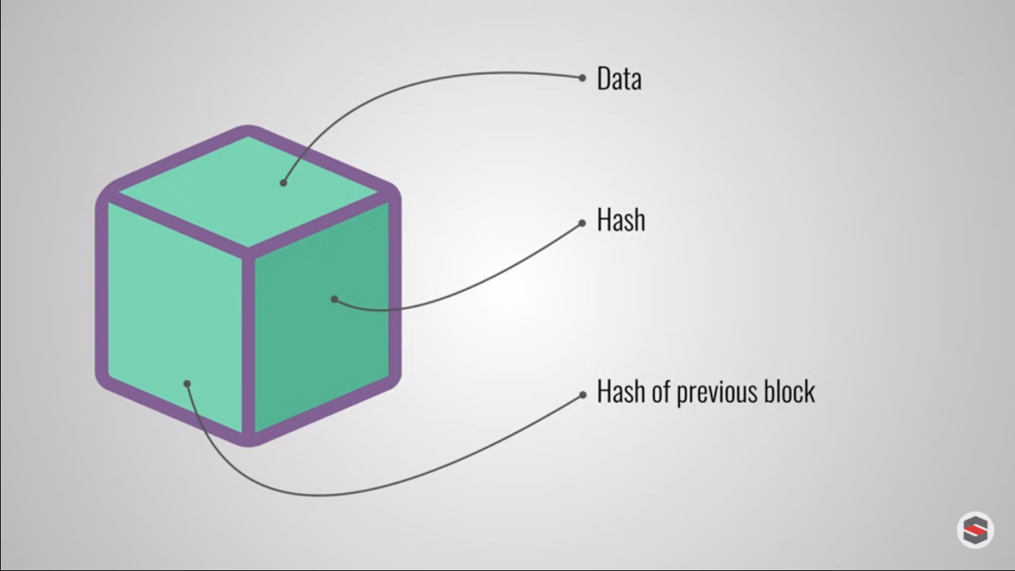
Blockchain
Blockchain is a specific type of database.
It differs from a typical database in the way it stores information; blockchains store data in blocks that are then chained together.
As new data comes in it is entered into a fresh block. Once the block is filled with data it is chained onto the previous block, which makes the data chained together in chronological order.
Different types of information can be stored on a blockchain but the most common use so far has been as a ledger for transactions.
In Bitcoin’s case, blockchain is used in a decentralized way so that no single person or group has control—rather, all users collectively retain control.

Slide 7
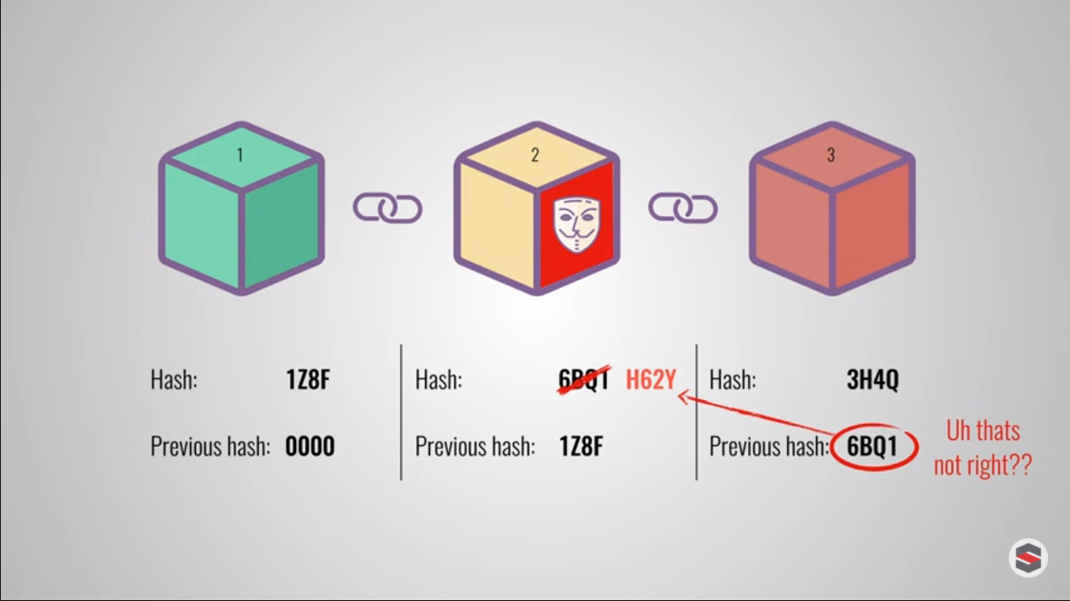
Blockchain - Storage Structures
A database structures its data into tables whereas a blockchain, like its name implies, structures its data into chunks (blocks) that are chained together.
This makes it so that all blockchains are databases but not all databases are blockchains.
This system also inherently makes an irreversible timeline of data when implemented in a decentralized nature.
When a block is filled it is set in stone and becomes a part of this timeline. Each block in the chain is given an exact timestamp when it is added to the chain.

Slide 8
Is Blockchain Secure?
Blockchain technology accounts for the issues of security and trust in several ways. First, new blocks are always stored linearly and chronologically. That is, they are always added to the “end” of the blockchain.
After a block has been added to the end of the blockchain, it is very difficult to go back and alter the contents of the block unless the majority reached a consensus to do so. That’s because each block contains its own hash, along with the hash of the block before it, as well as the previously mentioned time stamp. Hash codes are created by a math function that turns digital information into a string of numbers and letters. If that information is edited in any way, the hash code changes as well.

Slide 9
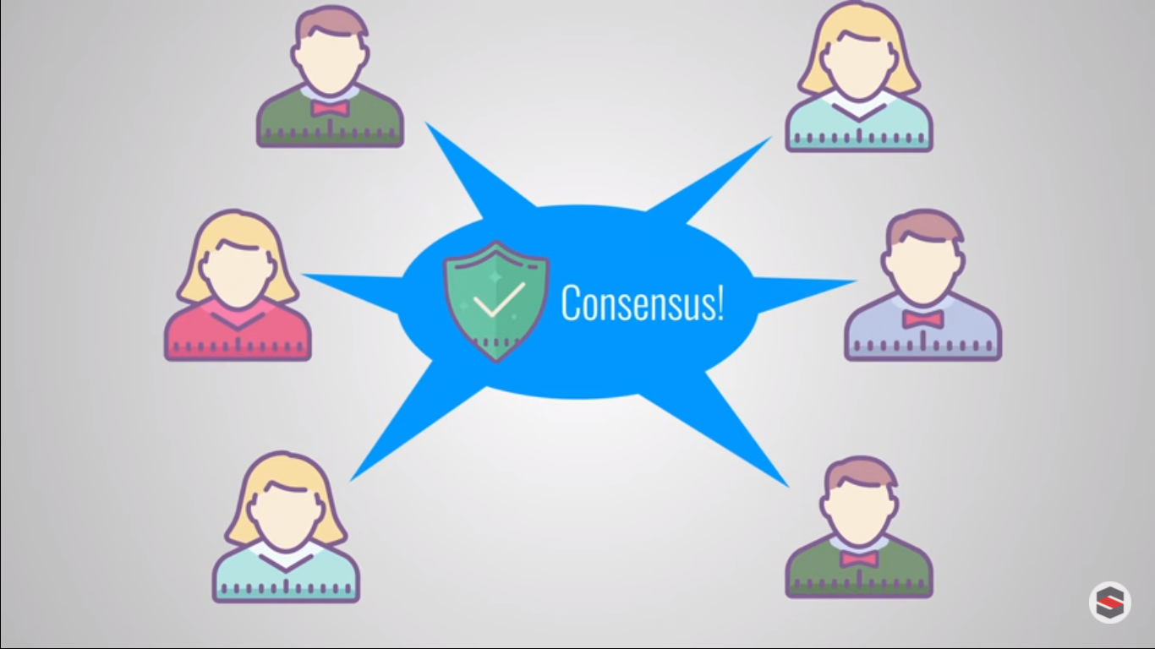
Is Blockchain Secure?
Here’s why that’s important to security. Let’s say a hacker wants to alter the blockchain and steal Bitcoin from everyone else. If they were to alter their own single copy, it would no longer align with everyone else's copy. When everyone else cross-references their copies against each other, they would see this one copy stand out and that hacker's version of the chain would be cast away as illegitimate.
Succeeding with such a hack would require that the hacker simultaneously control and alter 51% of the copies of the blockchain so that their new copy becomes the majority copy and thus, the agreed-upon chain. Such an attack would also require an immense amount of money and resources as they would need to redo all of the blocks because they would now have different timestamps and hash codes.

Slide 10
Bitcoin vs. Blockchain
The goal of blockchain is to allow digital information to be recorded and distributed, but not edited. Blockchain technology was first outlined in 1991 by Stuart Haber and W. Scott Stornetta, two researchers who wanted to implement a system where document timestamps could not be tampered with. But it wasn’t until almost two decades later, with the launch of Bitcoin in January 2009, that blockchain had its first real-world application.
The Bitcoin protocol is built on a blockchain.
The Bitcoin protocol is built on a blockchain. In a research paper introducing the digital currency, Bitcoin’s pseudonymous creator, Satoshi Nakamoto, referred to it as “a new electronic cash system that’s fully peer-to-peer, with no trusted third party”.

Slide 11
Bitcoin vs. Blockchain
Currently, there is a vast variety of blockchain-based projects looking to implement blockchain in ways to help society other than just recording transactions. One good example is that of blockchain being used as a way to vote in democratic elections. The nature of blockchain’s immutability means that fraudulent voting would become far more difficult to occur.
For example, a voting system could work such that each citizen of a country would be issued a single cryptocurrency or token. Each candidate would then be given a specific wallet address, and the voters would send their token or crypto to whichever candidate's address they wish to vote for. The transparent and traceable nature of blockchain would eliminate the need for human vote counting as well as the ability of bad actors to tamper with physical ballots.

Slide 12
Blockchain
Pros
Improved accuracy by removing human involvement in verification
Cost reductions by eliminating third-party verification
Decentralization makes it harder to tamper with
Transactions are secure, private, and efficient
Transparent technology
Provides a banking alternative and way to secure personal information for citizens of countries with unstable or underdeveloped governments
Cons
Significant technology cost associated with mining bitcoin
Low transactions per second
History of use in illicit activities

Slide 13
How is Blockchain Used?
As we now know, blocks on Bitcoin’s blockchain store data about monetary transactions. But it turns out that blockchain is actually a reliable way of storing data about other types of transactions, as well.
Some companies that have already incorporated blockchain include Walmart, Pfizer, AIG, Siemens, Unilever, and a host of others. For example, IBM has created its Food Trust blockchain¹
﻿ to trace the journey that food products take to get to its locations.
Why do this? The food industry has seen countless outbreaks of e Coli, salmonella, listeria, as well as hazardous materials being accidentally introduced to foods. In the past, it has taken weeks to find the source of these outbreaks or the cause of sickness from what people are eating.

Slide 14
How is Blockchain Used?
Using blockchain gives brands the ability to track a food product’s route from its origin, through each stop it makes, and finally its delivery. If a food is found to be contaminated, then it can be traced all the way back through each stop to its origin.
Not only that, but these companies can also now see everything else it may have come in contact with, allowing the identification of the problem to occur far sooner, potentially saving lives. This is one example of blockchains in practice, but there are many other forms of blockchain implementation.

Slide 15
How is Blockchain Used?
Banking and Finance
Currency
Healthcare
Records of Property
Smart Contracts
Supply Chains
Voting

Slide 16
Review Questions
What a block chain is?
How it works on basic level?
What problems it solves?
List at least two Pros and Cons of Block chain.
How is block chain used?

Slide 17
Summary / Recap of Main Points
Block chain
Storage Structure
Security
Usage

Slide 18
What To Expect Next Week
In Class
Preparation for Class
Discuss in detail the advantages of blockchain in DS
Differentiate various types of distributed ledger systems
Security Issues in DS

